Slide 1
Basic Concepts
Instructor
Ms. Yasmin Shaikh

Slide 2
Three Basic Concepts
Languages
Grammars
Automata

Slide 3
Languages
A system suitable for expression of certain ideas, facts, or concepts
includes a set of indivisible symbols and rules for their manipulation (grammar).

Slide 4
Natural languages

Slide 5
Programming Languages

Slide 6
Formal Languages
The word ‘formal’ means strictly formed by rules.
A language is a set of strings.
Alphabet:
  A non-empty set of indivisible symbols
  Denoted by Σ
  Examples :
  Σ₁ = {a,b,….,z}
  Σ₂ = {0,….,9}
  Σ₃ = {+,-,*}

Slide 7
Strings
Finite sequence of letters (symbols from the alphabet)
Example:
Σ = {a,b} then abba and ababb are strings on Σ
Convention
  Lower case letters a,b,c…. are used for elements of Σ and u,v,w…. for string names as w = aabb.
Empty String/ Null String
  is a string with no symbols at all.
  represented by λ or ε

Slide 8

The * Operation
Closure of a String/ Kleene Closure:
  denoted by Σ*
  Set of all strings over Σ including empty string.

Slide 9
The + Operation
Positive Closure/ Semi group Closure:
  denoted by Σ⁺
  Set of all strings over Σ including empty string.
  Σ⁺ = Σ* - {λ }

Slide 10
Length of String
number of symbols in the string
length of a string w is denoted by |w|
Examples
  Σ = {a,b} then |abaab| = 5
  Σ = {1,2} then |11| = 2
  Σ = {11,12} then |11| = 1

Slide 11
Substring, Prefix and Suffix
Substring: Any string of consecutive characters in some w is said to be a substring of w.
Prefix: A prefix of a string is a substring of leading symbols of that string
Proper Prefix: A proper prefix of a string is a substring of leading symbols of that string except the string itself.
Suffix: A suffix of a string is a substring of trailing symbols of that string
Proper Suffix: A proper suffix of a string is a substring of trailing symbols of that string except the string itself

Slide 12
Example
Let w = abb then
Substings
λ
a
ab
bb
abb
Prefix
λ
a
ab
abb
Suffix
b
bb
abb
λ
Proper Prefix
λ
a
ab
Proper Suffix
b
bb
λ

Slide 13
Concatenation & Reverse of strings
Concatenation of string: The concatenation of two strings w and v is the string obtained by appending the symbols of v to the end of w
w = abcd v = 1234
wv = abcd1234
Reverse of String: The reverse of string is obtained by writing the symbols in reverse order
w^{R} = dcba

Slide 14
Properties of String w.r.t. Concatenation operation
For each x,y,z in Σ*
Concatenation on a set Σ* is associative x(yz) = (xy)z
Identity element: The set Σ* has an identity element λ w.r.t. concatenation operation
xλ = λx= x

Slide 15
Contd…
Has left and right cancellation.
zx = zy => x = y (left cancellation)
xz = yz => x = y (right cancellation)
4. |xy| = |x| + |y|,
here |x|, |y|, |xy| denote the length of the strings x, y and xy.

Slide 16

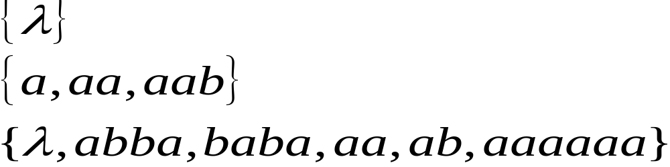
Languages
A language is any subset of
Example:
Language:

Slide 17
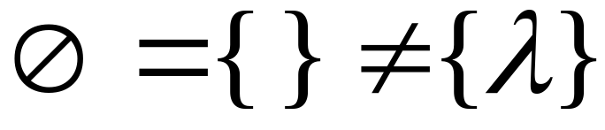



Note that:
Sets
Set size
Set size
String length

Slide 18




Another Example
An infinite language

Slide 19
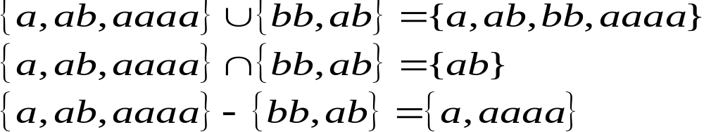

Operations on Languages
The usual set operations
Complement

Slide 20

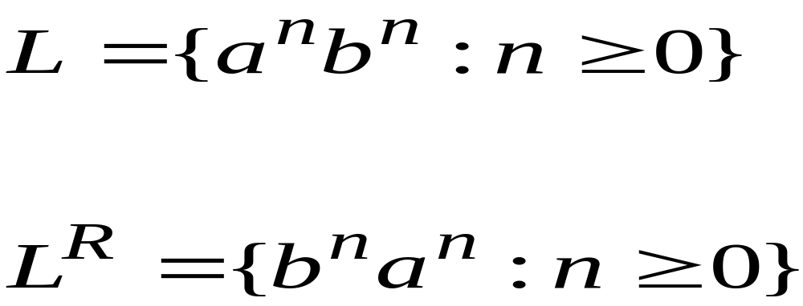
Reverse
Definition
Examples

Slide 21


Concatenation
Definition
Example

Slide 22


Another Operation
Definition
Example

Slide 23

Contd..
Special case

Slide 24


Star-Closure (Kleene *)
Definition
Example

Slide 25
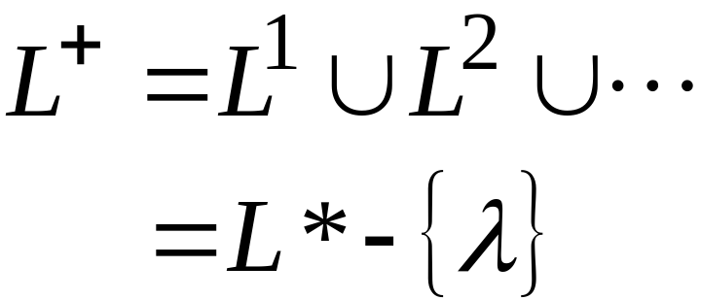

Positive Closure
Definition
Example

Slide 26
Exercise
Give all prefixes, suffixes and substrings of aabbcd and aaabb.
Give the set of strings generated by
L = {a^{n}b^{m} | n<=m+3}
L = {a^{n}b^{m} | n = 2m}

Slide 27
Assignments
Explain Natural language, Computer Language and Formal Language with suitable alphabet.
What are various operations other than concatenation over string? Highlight your ideas.
When will you say that the strings are ordered? What are the relationships for ordering that may exist for string? Explain them with example.
Give all prefixes, suffixes and substrings of abcd
Prove or disprove L⁺ = L*-{e}
Let h be the homomorphism defined by h(0) = a and h(1) = bb and h(2) ={e}. What is h(L) where L={012}*.

